Slide 1


智冠科技 數位發展中心
Google Cloud Platform Tutorial
智冠科技

Slide 2
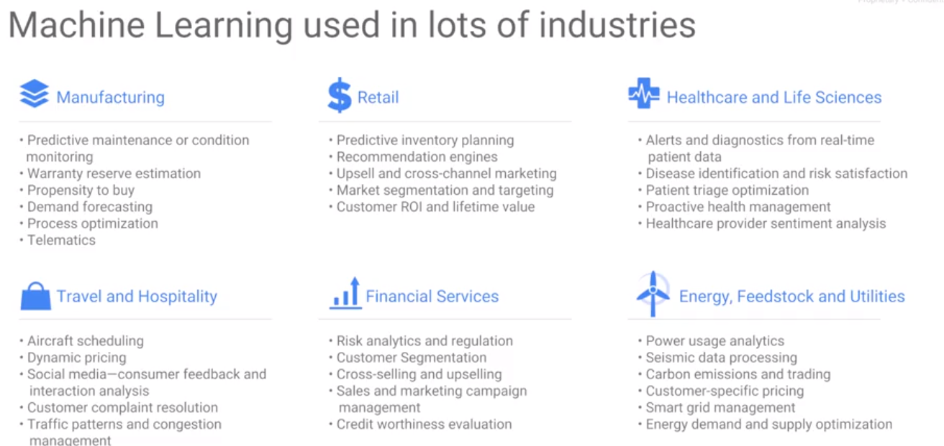
ML concept
Machine Learning

Slide 3
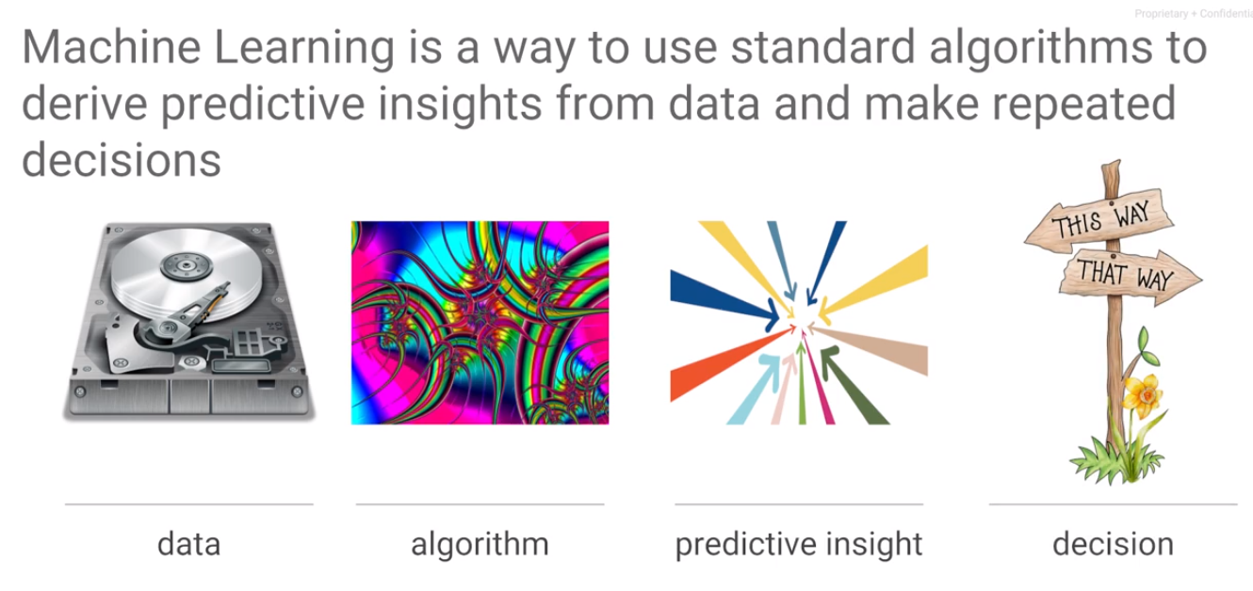
ML concept
Machine Learning

Slide 4
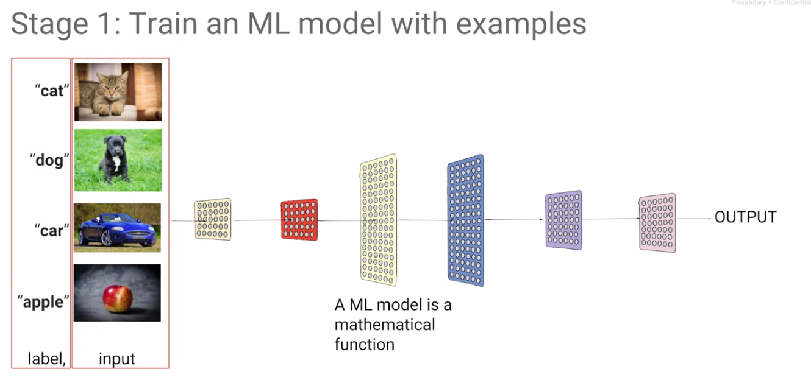
ML concept
Machine Learning

Slide 5
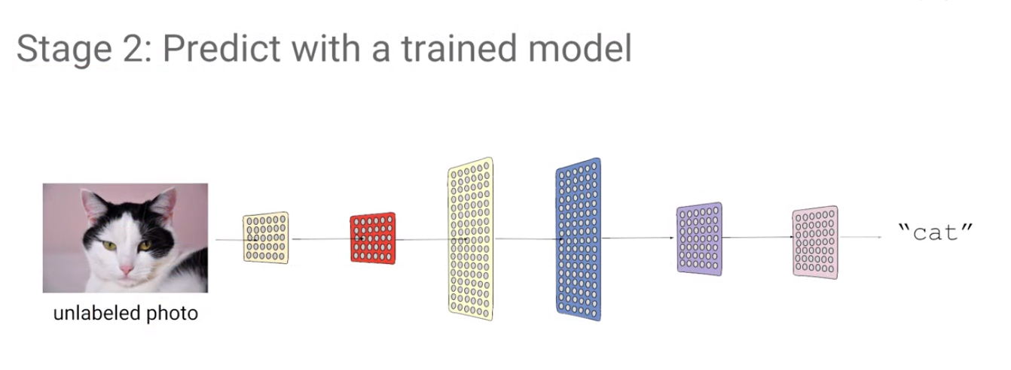
ML concept
Machine Learning

Slide 6
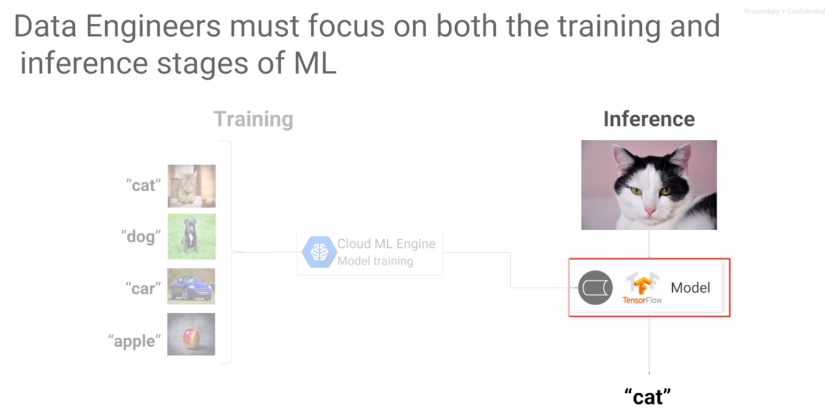
ML concept
Machine Learning

Slide 7
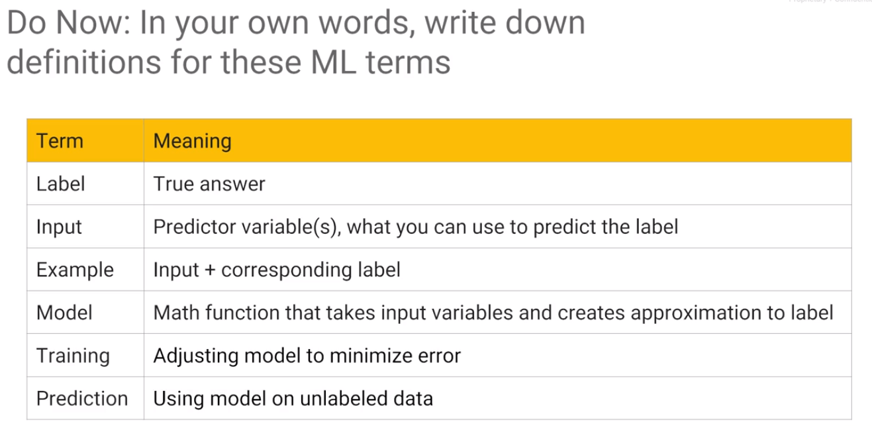
ML concept
Machine Learning

Slide 8
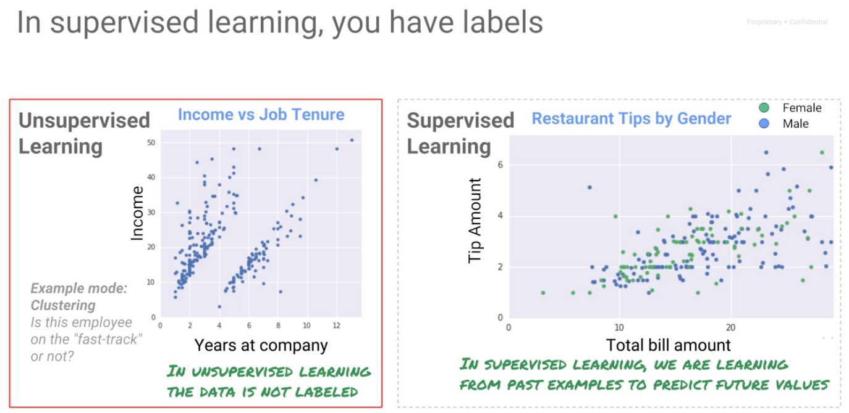
ML concept
Machine Learning

Slide 9
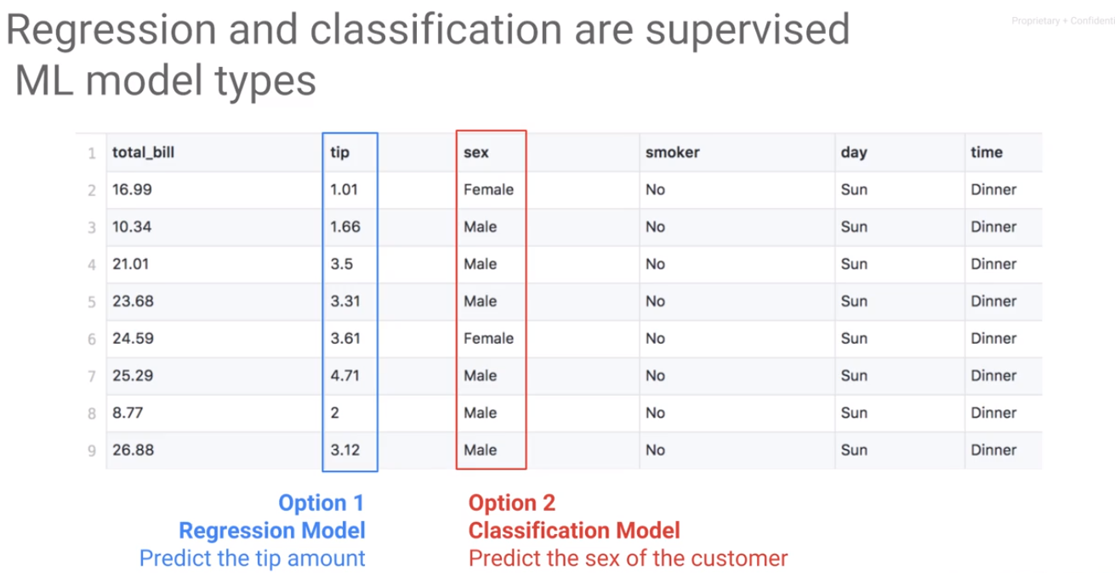
ML concept
Machine Learning

Slide 10
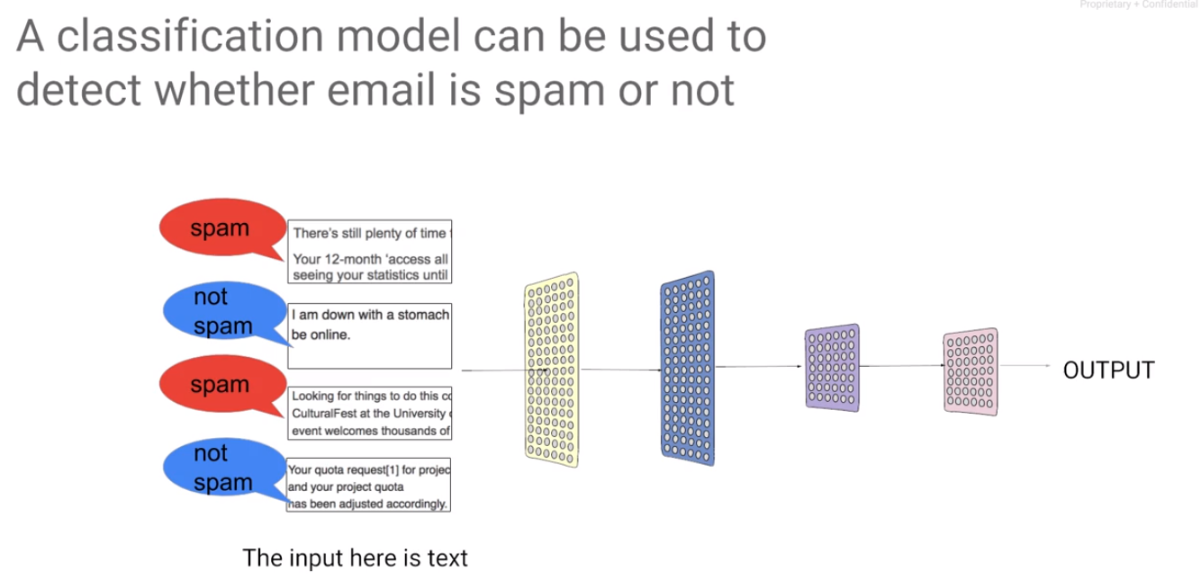
ML concept
Machine Learning

Slide 11
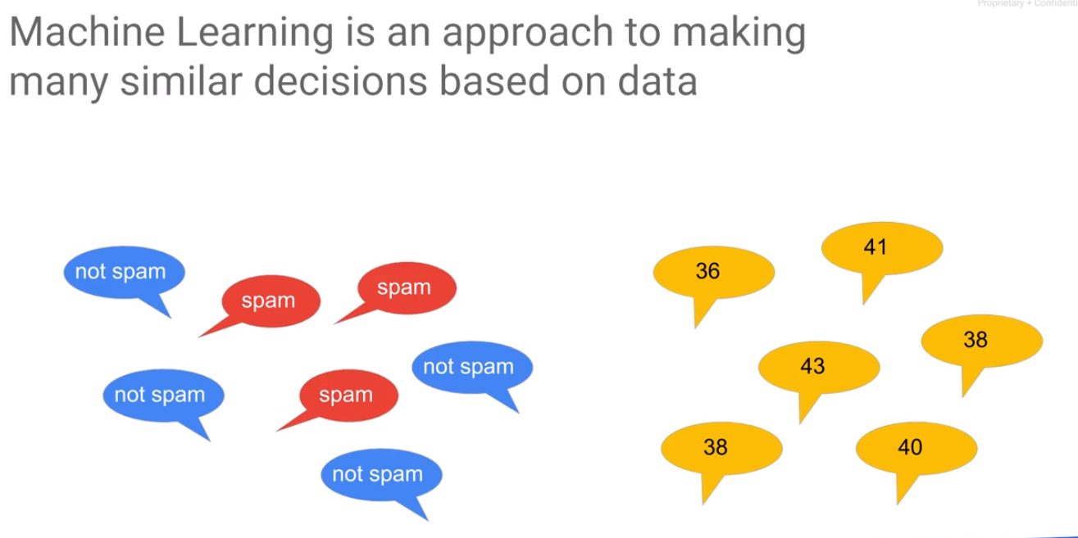
ML concept
Machine Learning

Slide 12
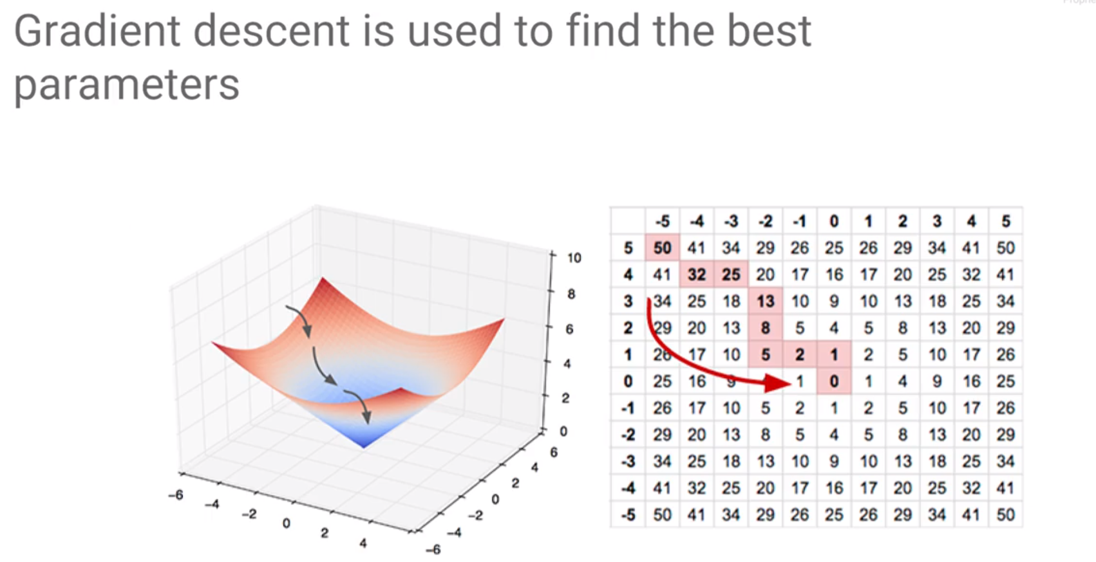
ML concept
Machine Learning

Slide 13
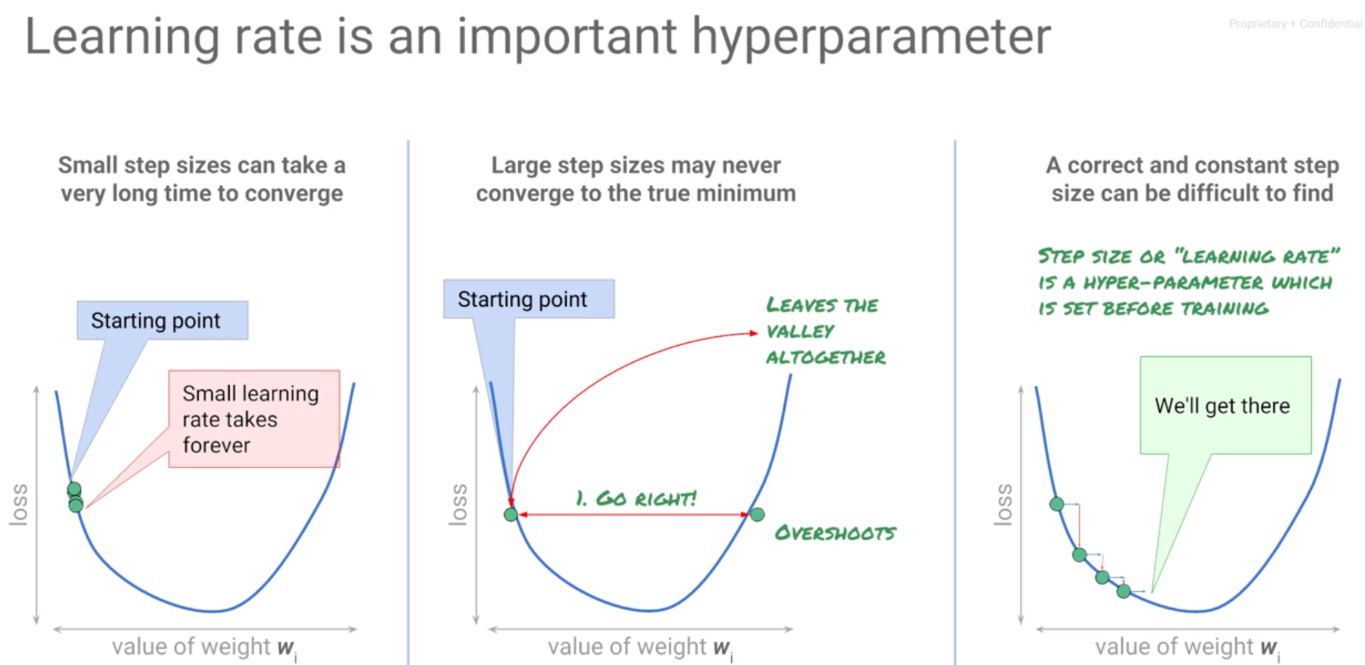
ML concept
Machine Learning

Slide 14
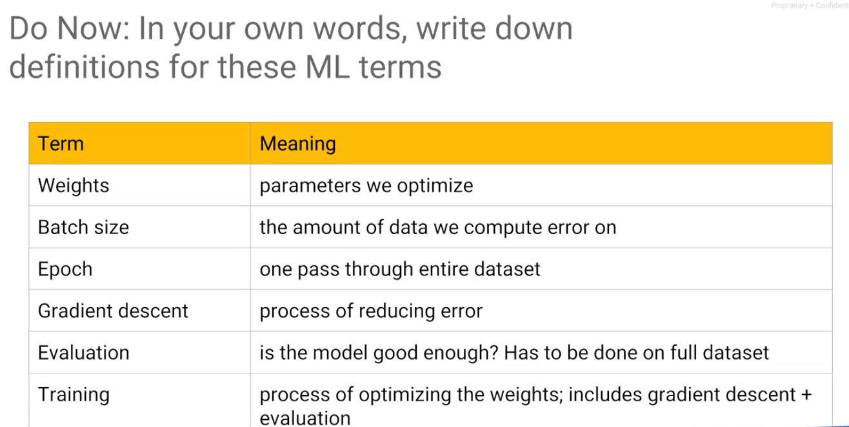
ML concept
Machine Learning

Slide 15
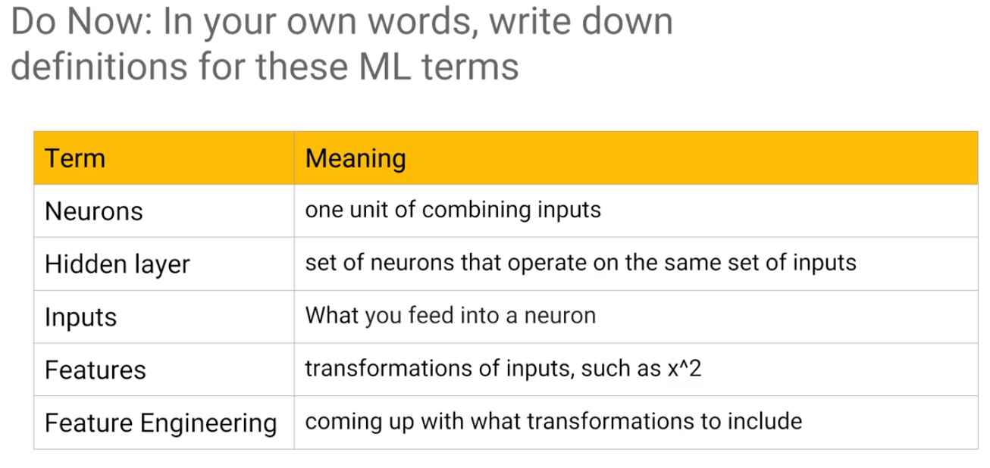
ML concept
Machine Learning

Slide 16
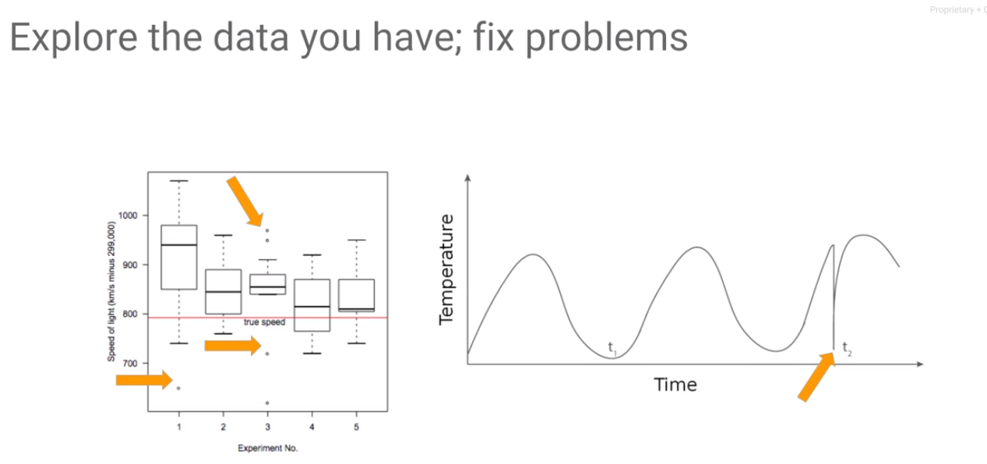
ML concept
Machine Learning

Slide 17
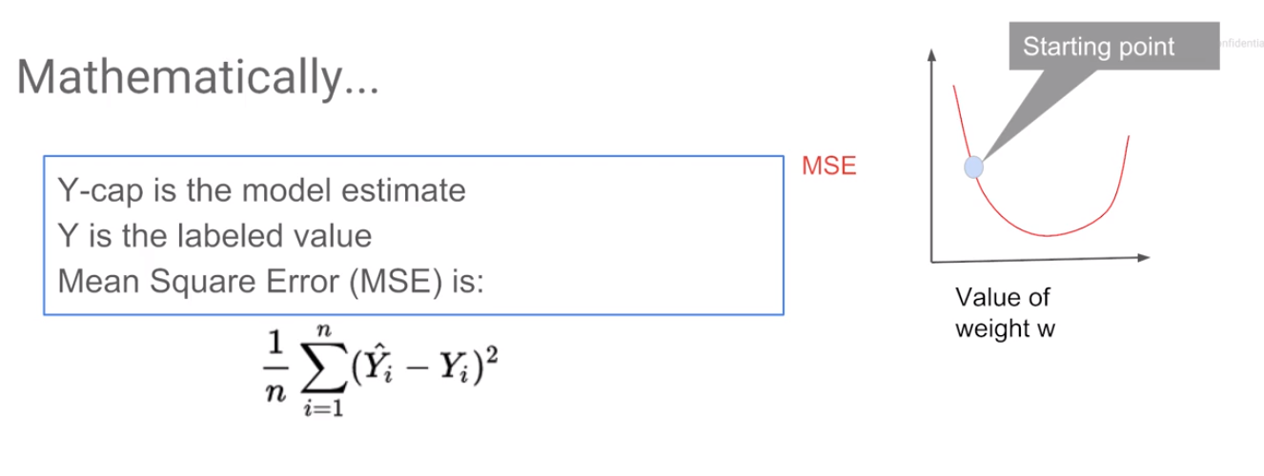
ML concept
Machine Learning

Slide 18
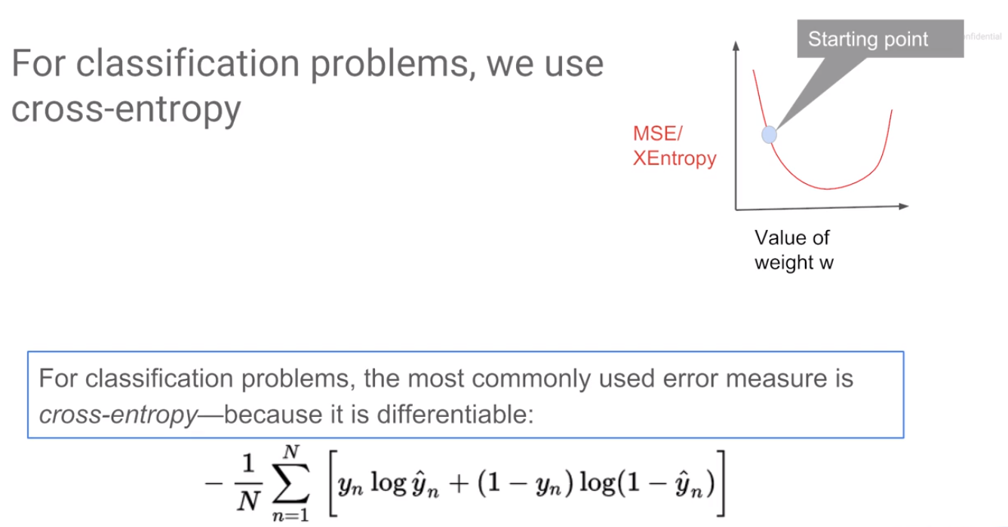
ML concept
Machine Learning
Log loss

Slide 19
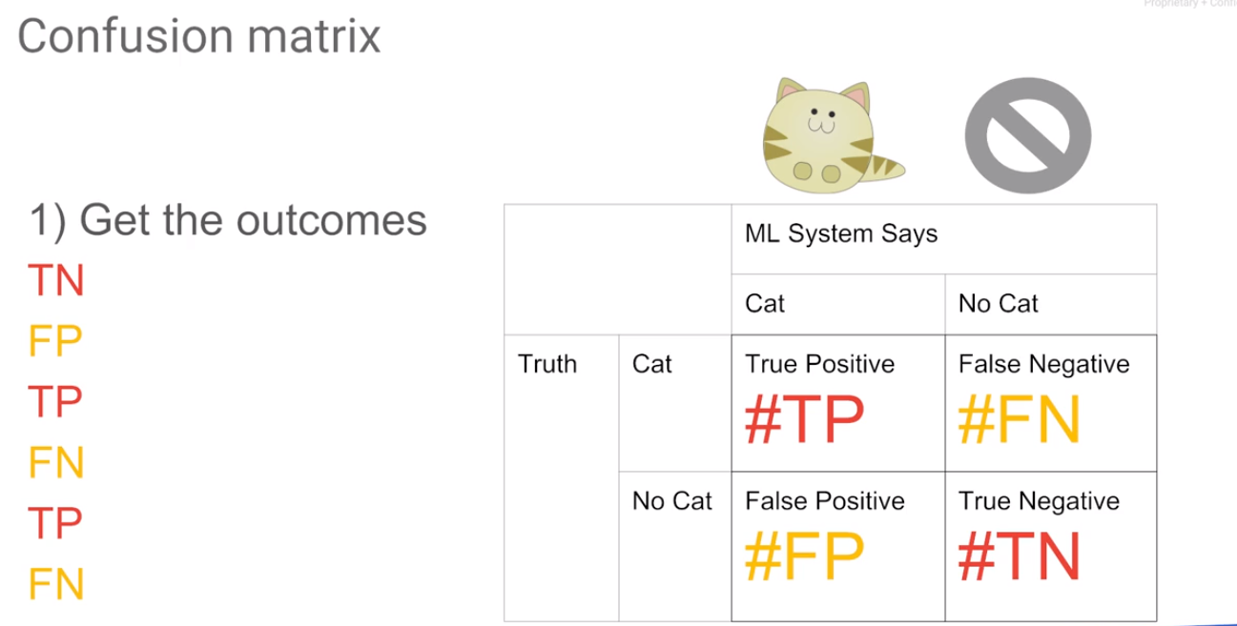
ML concept
Machine Learning

Slide 20
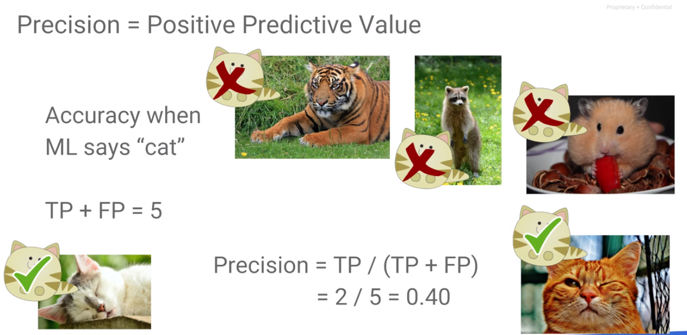
ML concept
Machine Learning

Slide 21
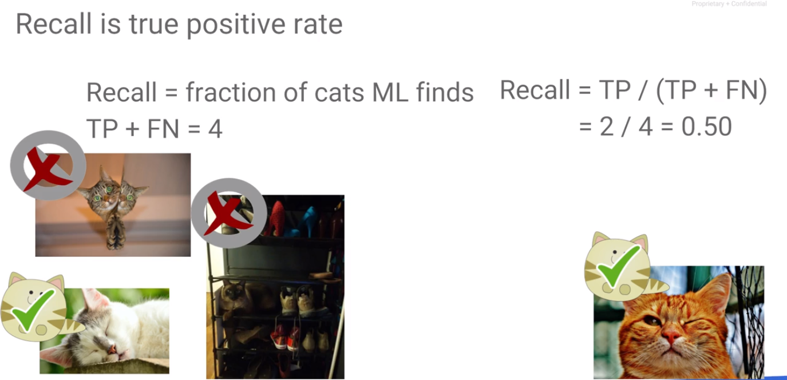
ML concept
Machine Learning

Slide 22
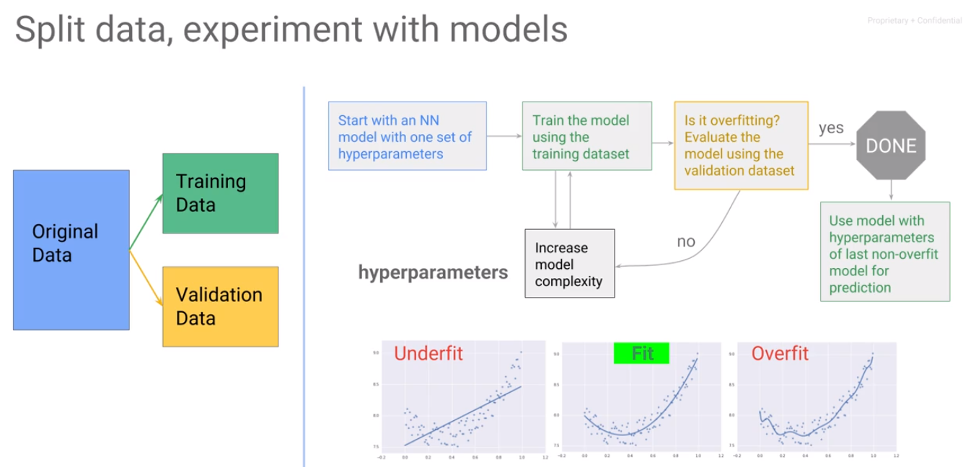
ML concept
Machine Learning

Slide 23
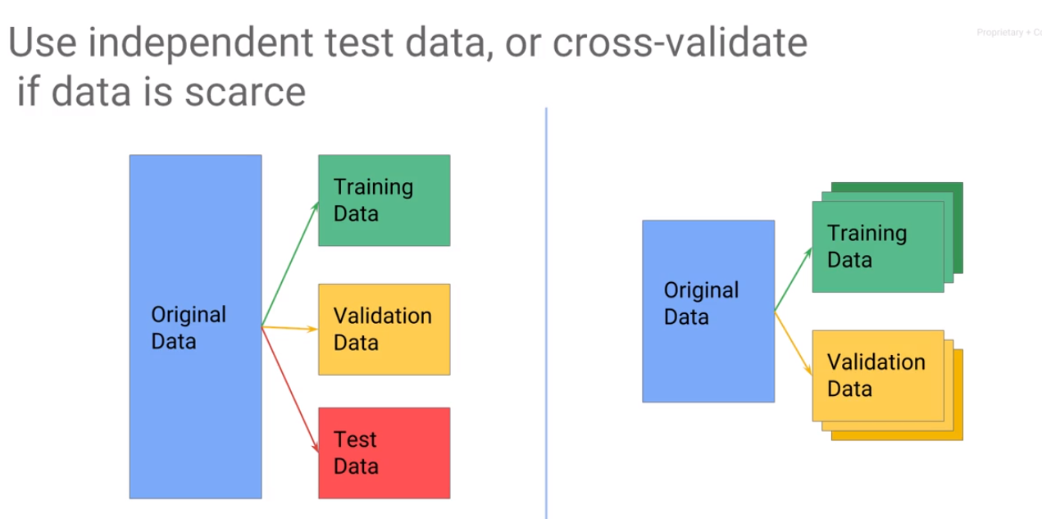
ML concept
Machine Learning

Slide 24
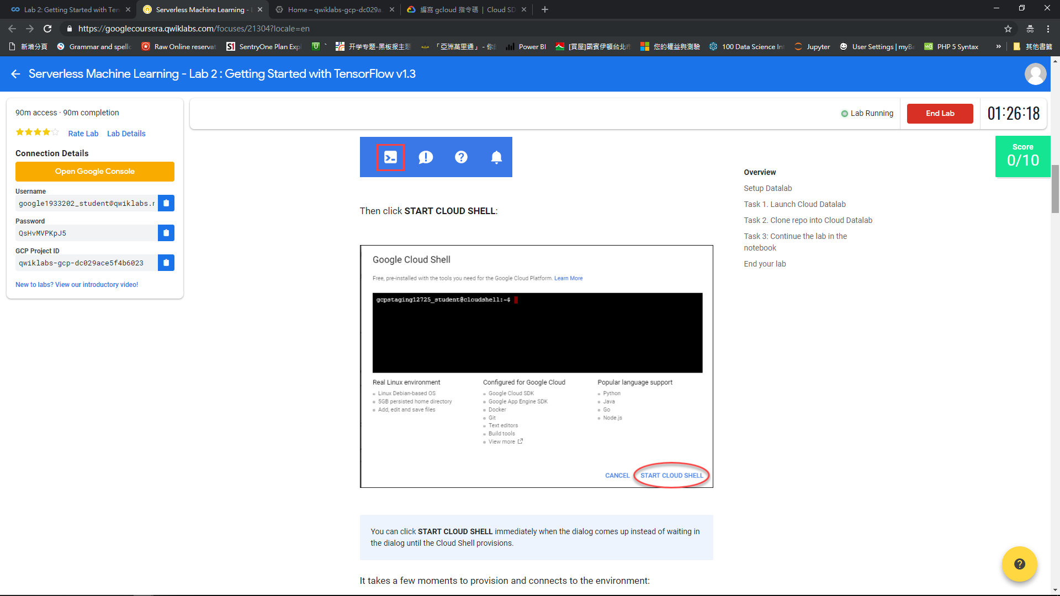

Slide 25
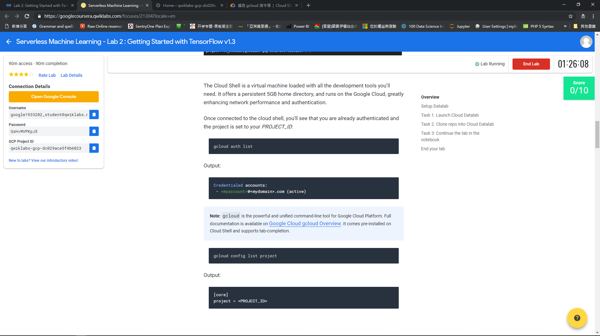

Slide 26
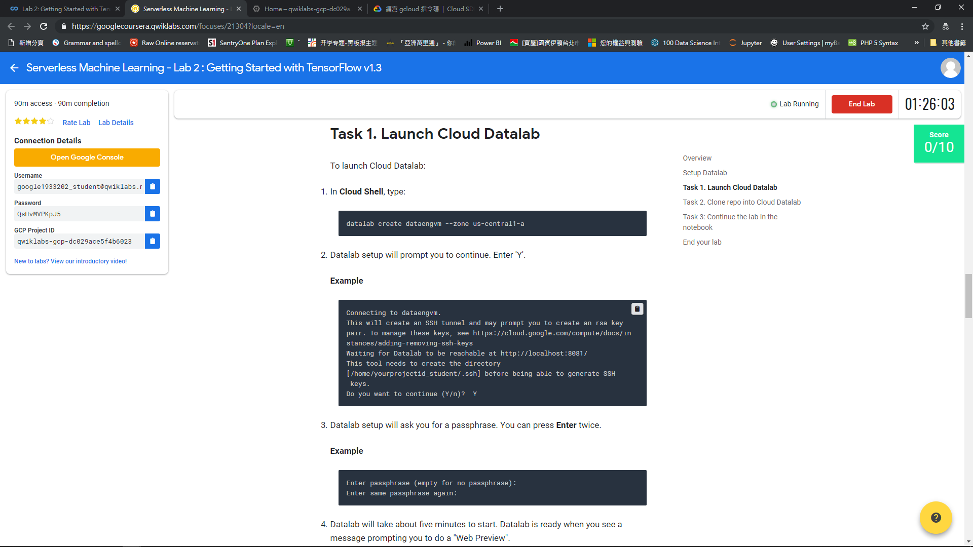

Slide 27
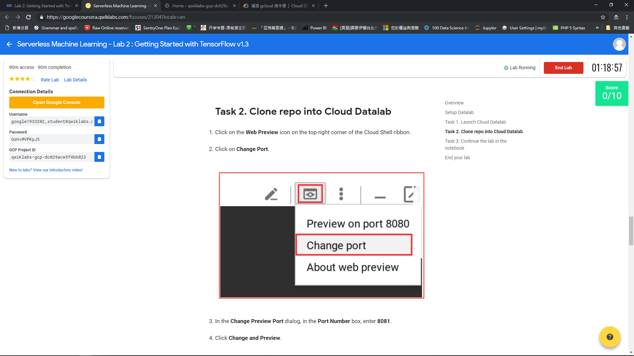

Slide 28
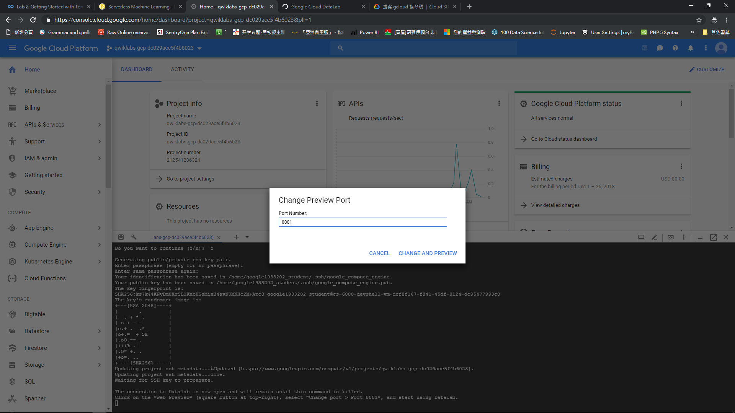

Slide 29
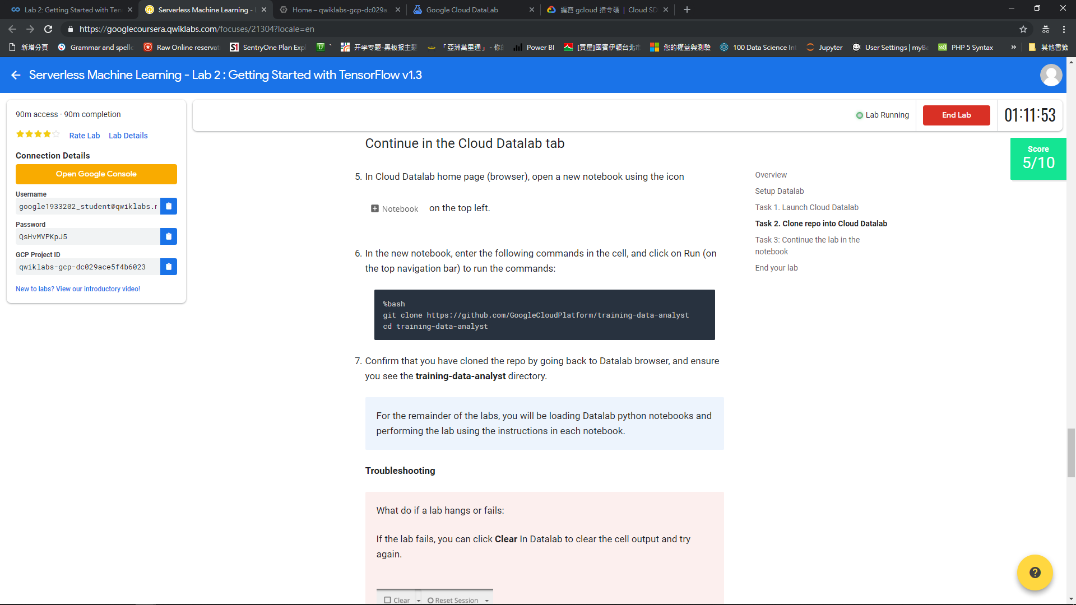

Slide 30
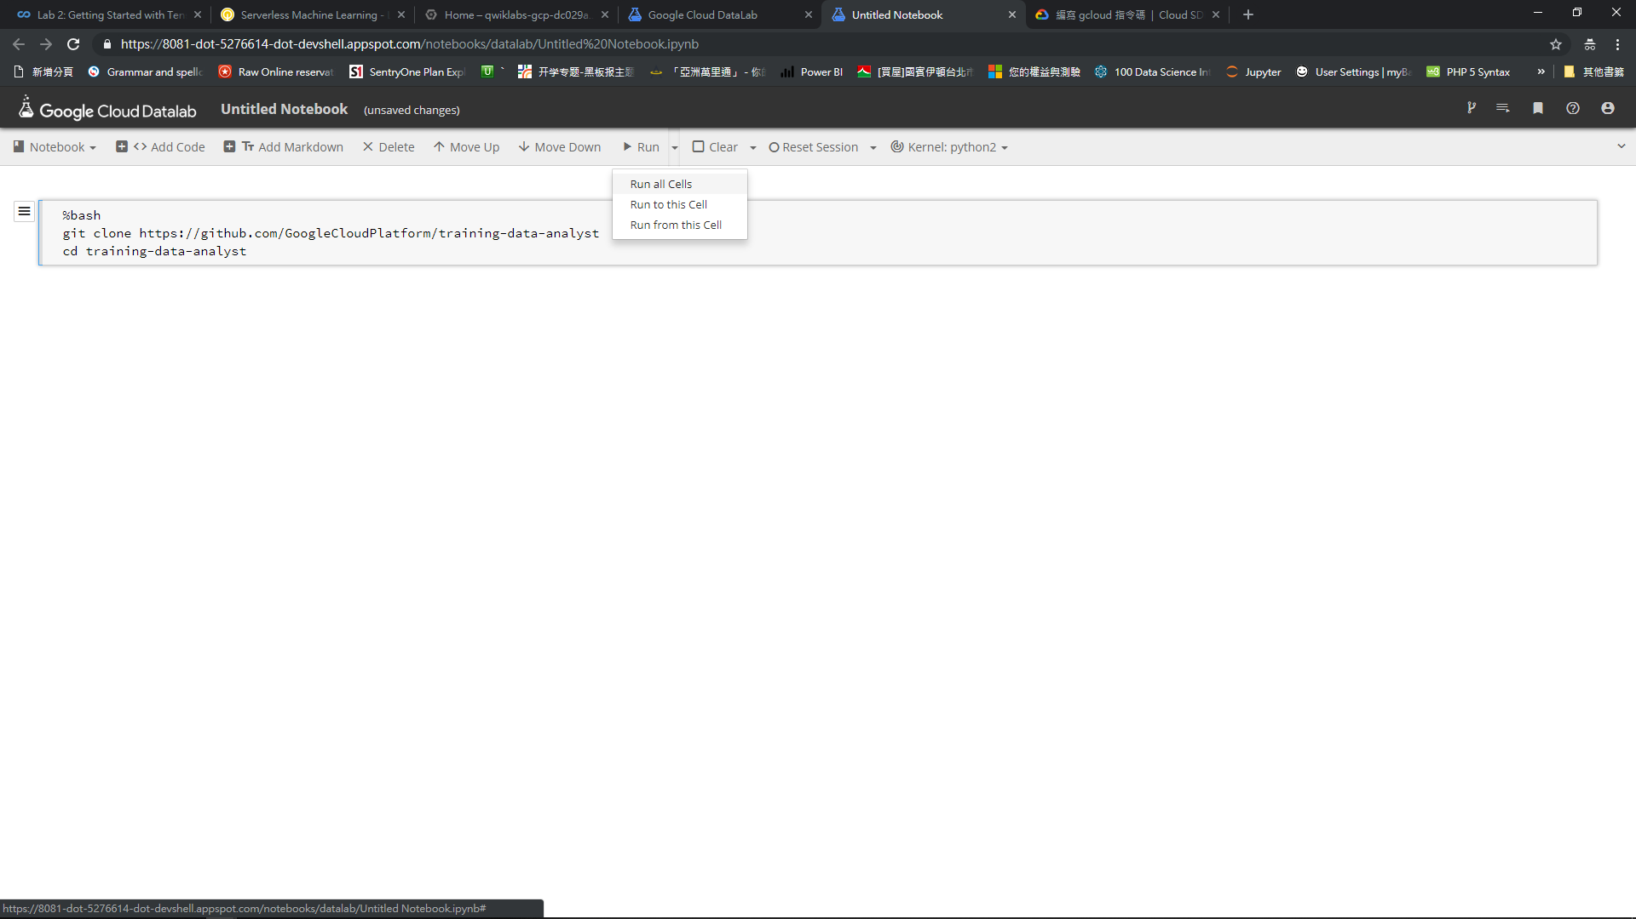

Slide 31
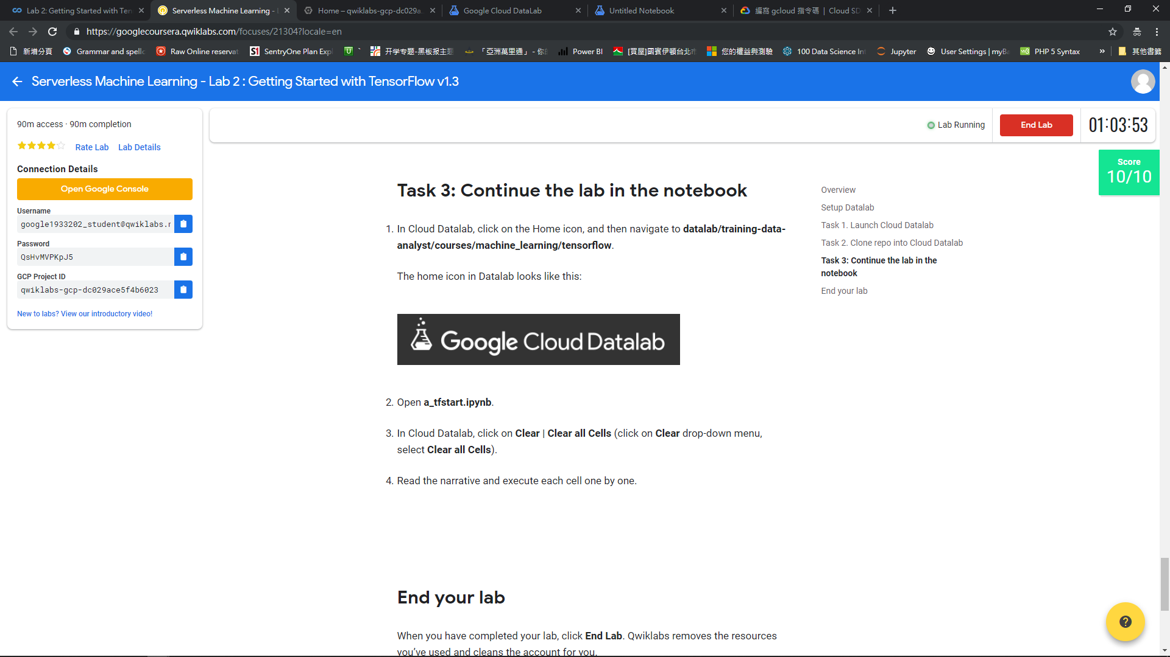

Slide 32
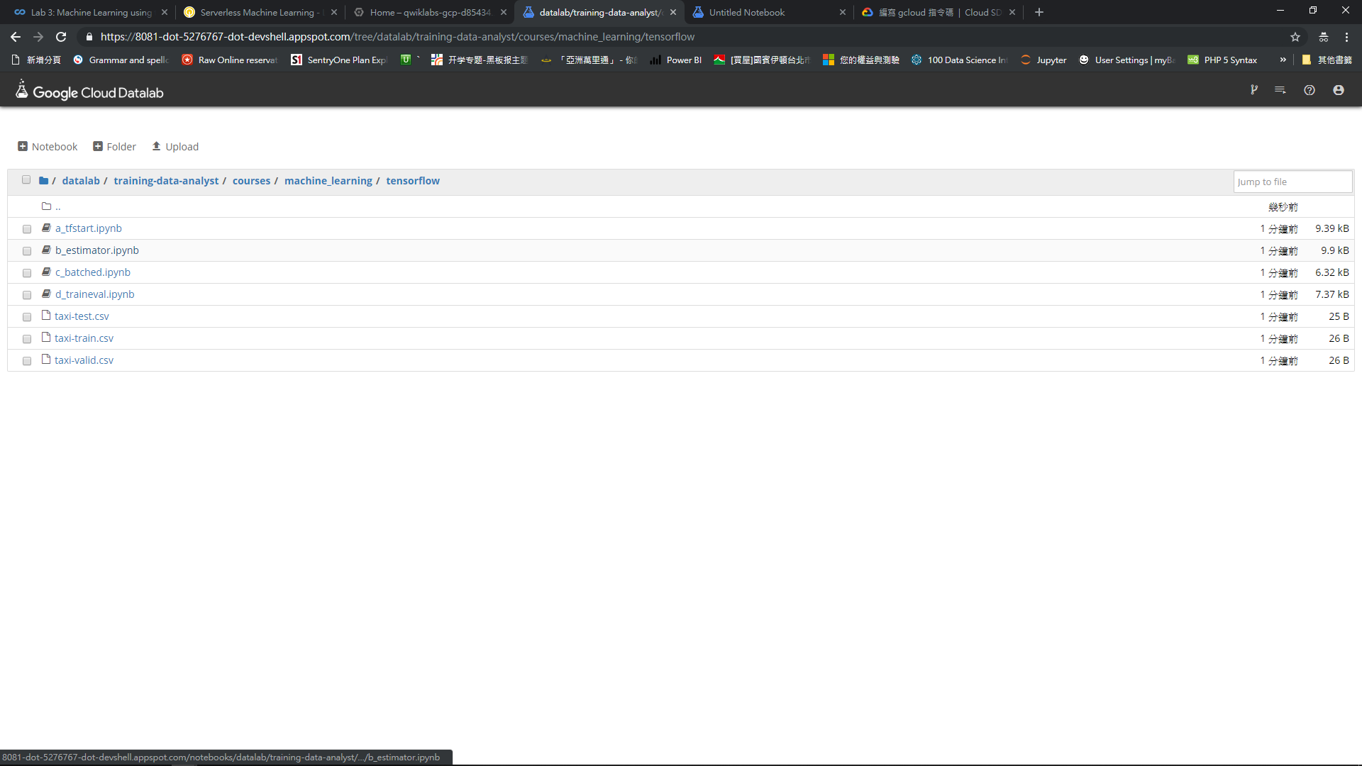

Slide 33
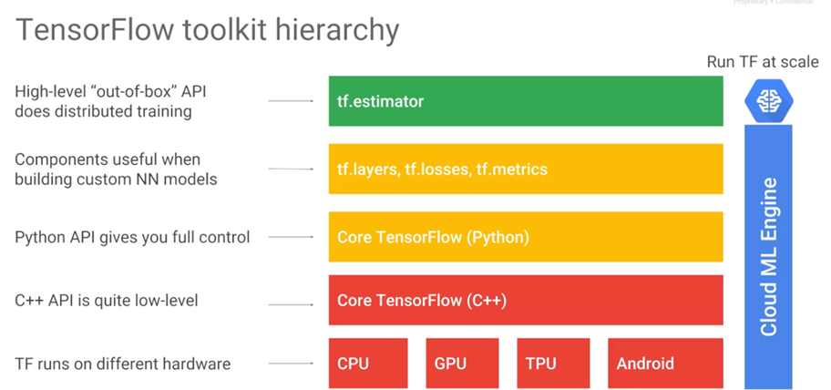
ML concept
Machine Learning

Slide 34
ML concept
Machine Learning

Slide 35
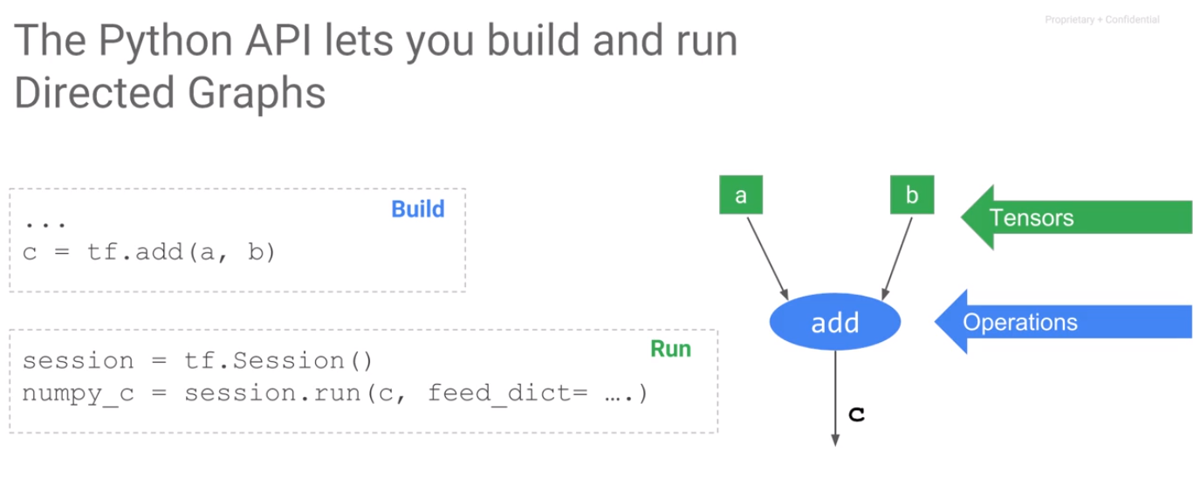
ML concept
Machine Learning

Slide 36
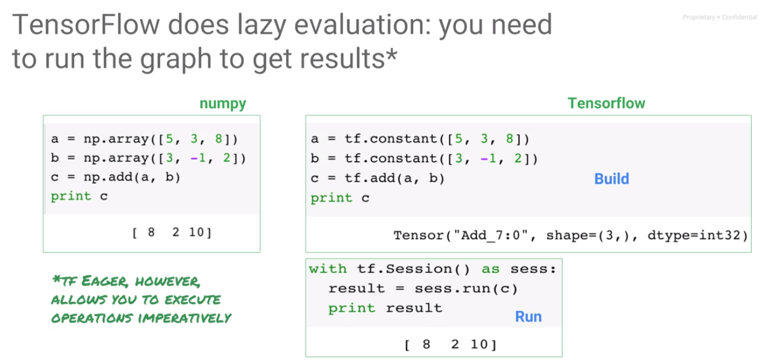
ML concept
Machine Learning
C is a Tensor run a Tensor to get the value

Slide 37
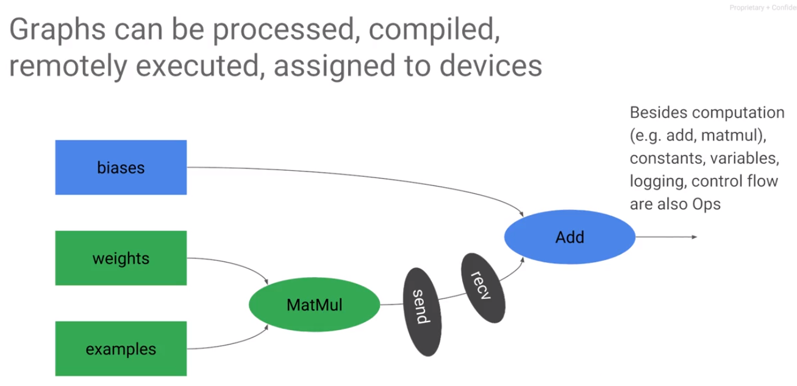
ML concept
Machine Learning
Abilities to change the graph TensorFlow can also process the graph to add quantization, debug nodes, create summaries

Slide 38
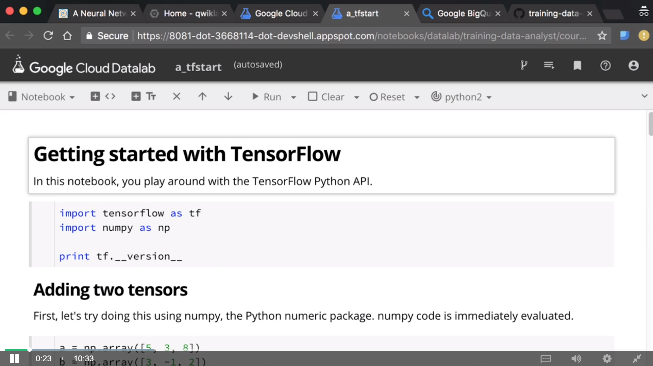

Slide 39
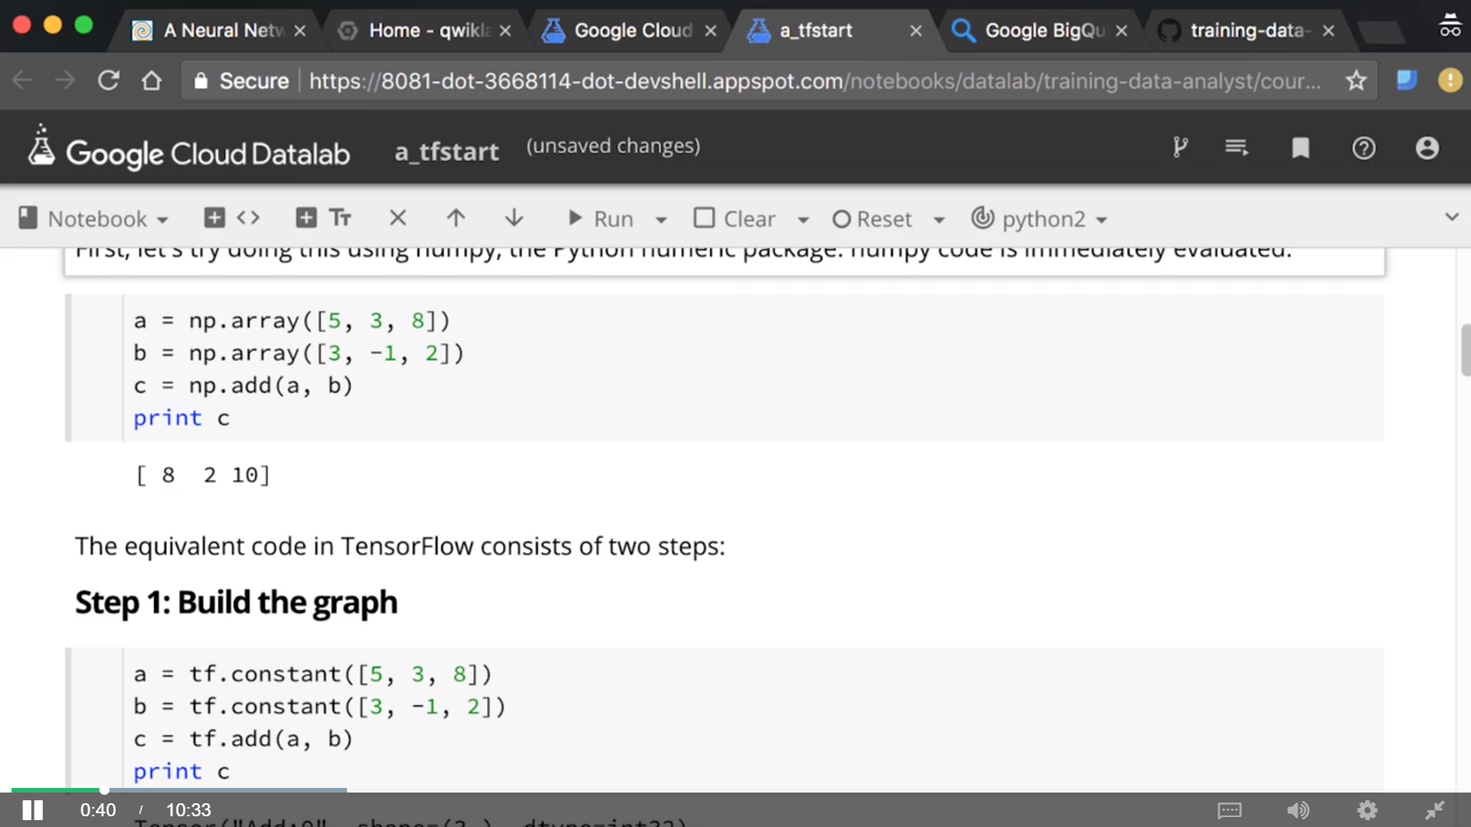

Slide 40
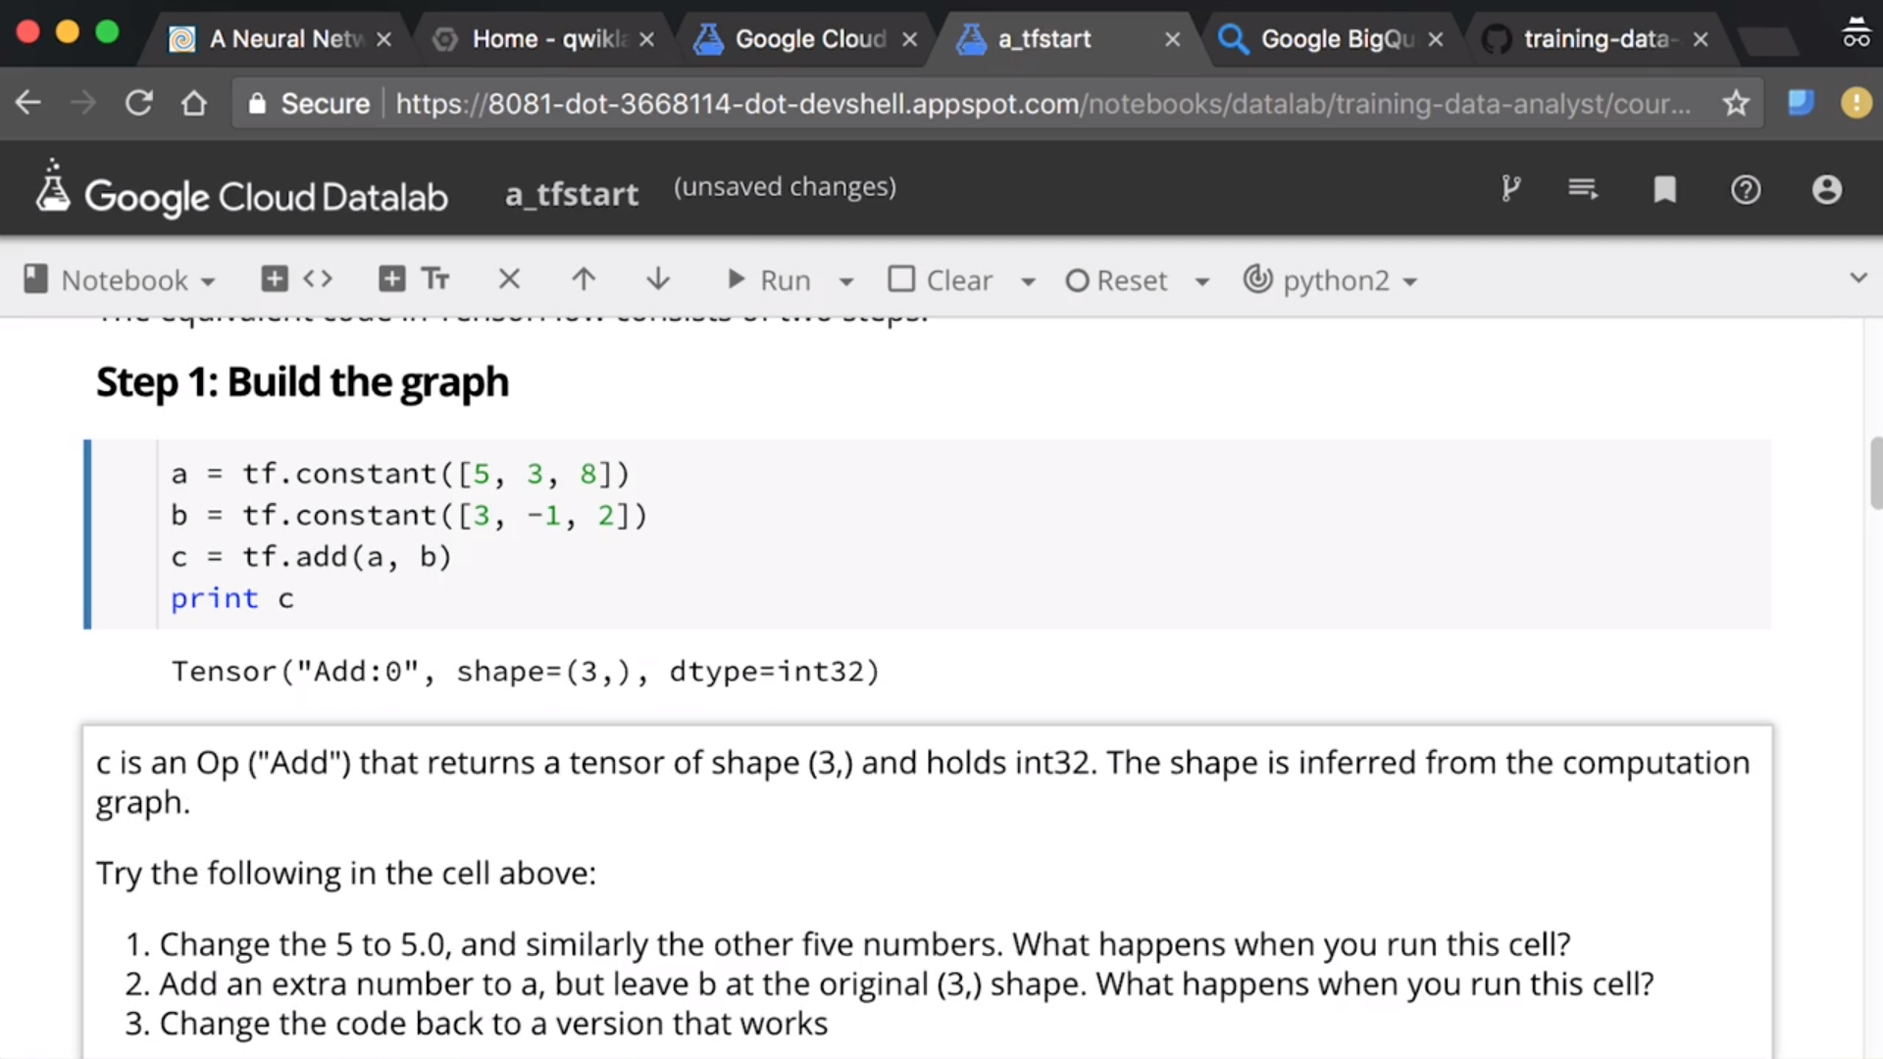

Slide 41
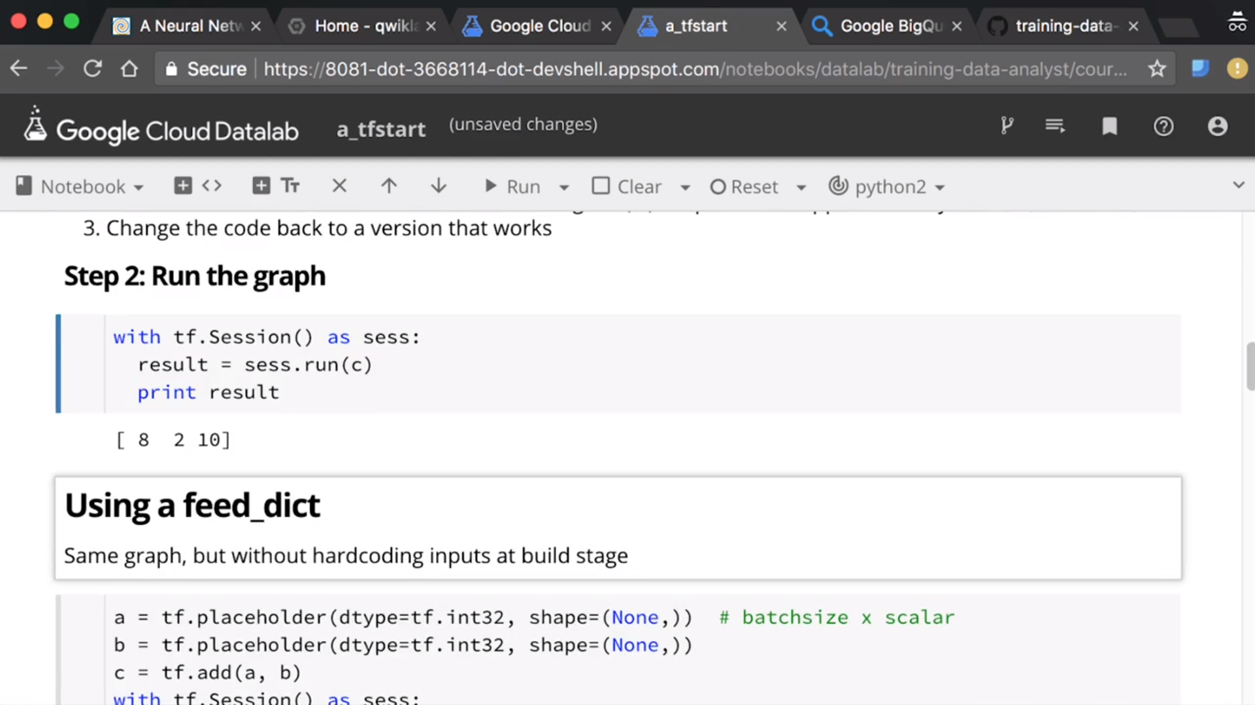

Slide 42
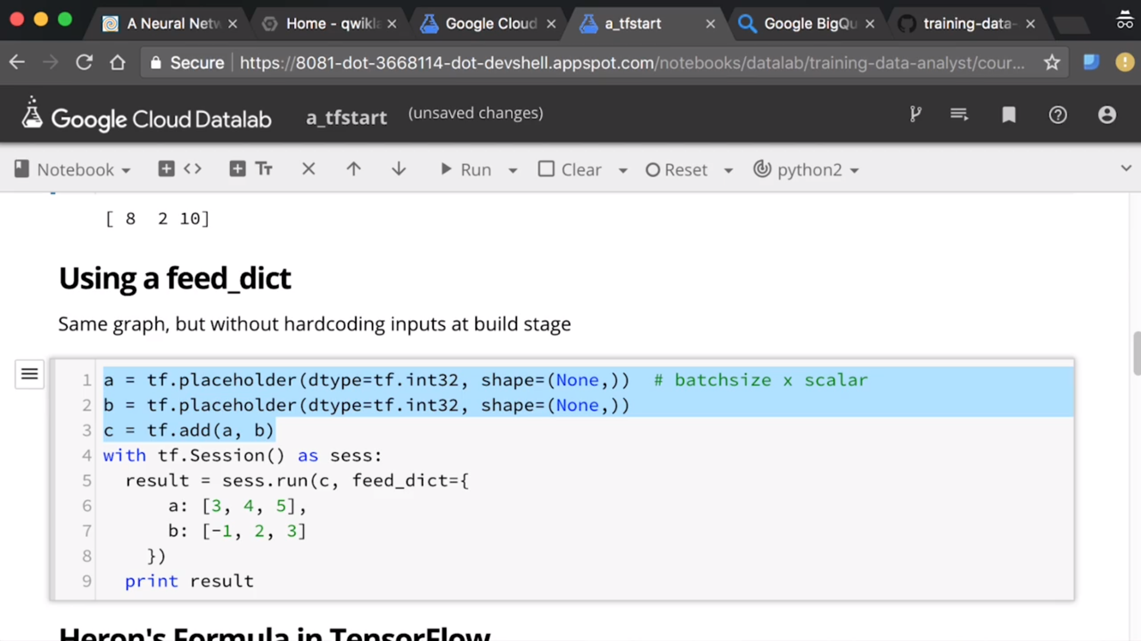

Slide 43
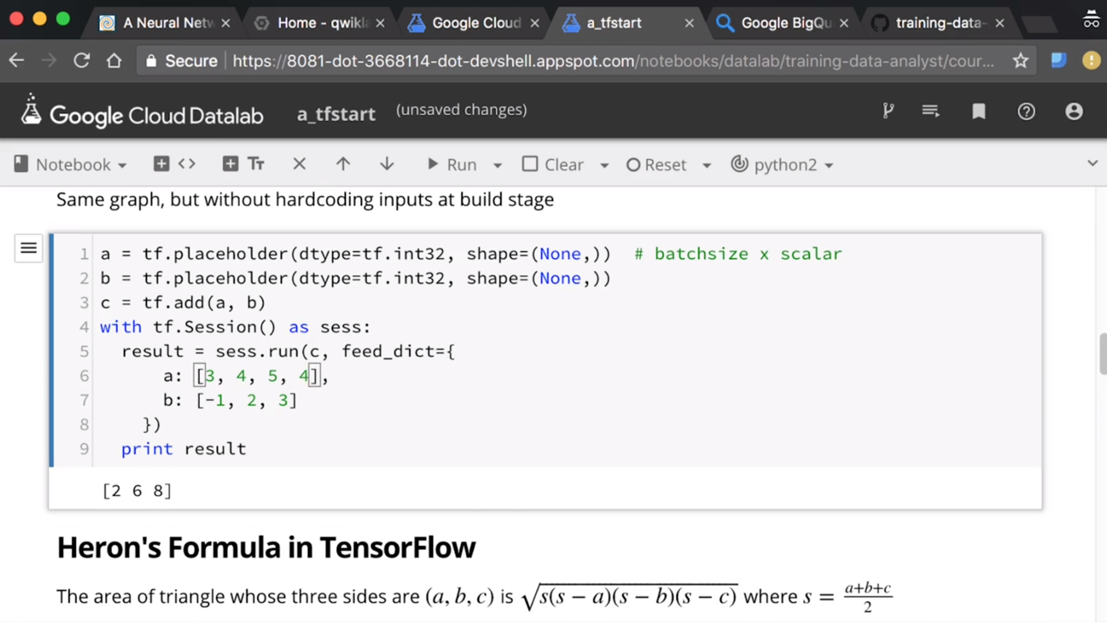

Slide 44
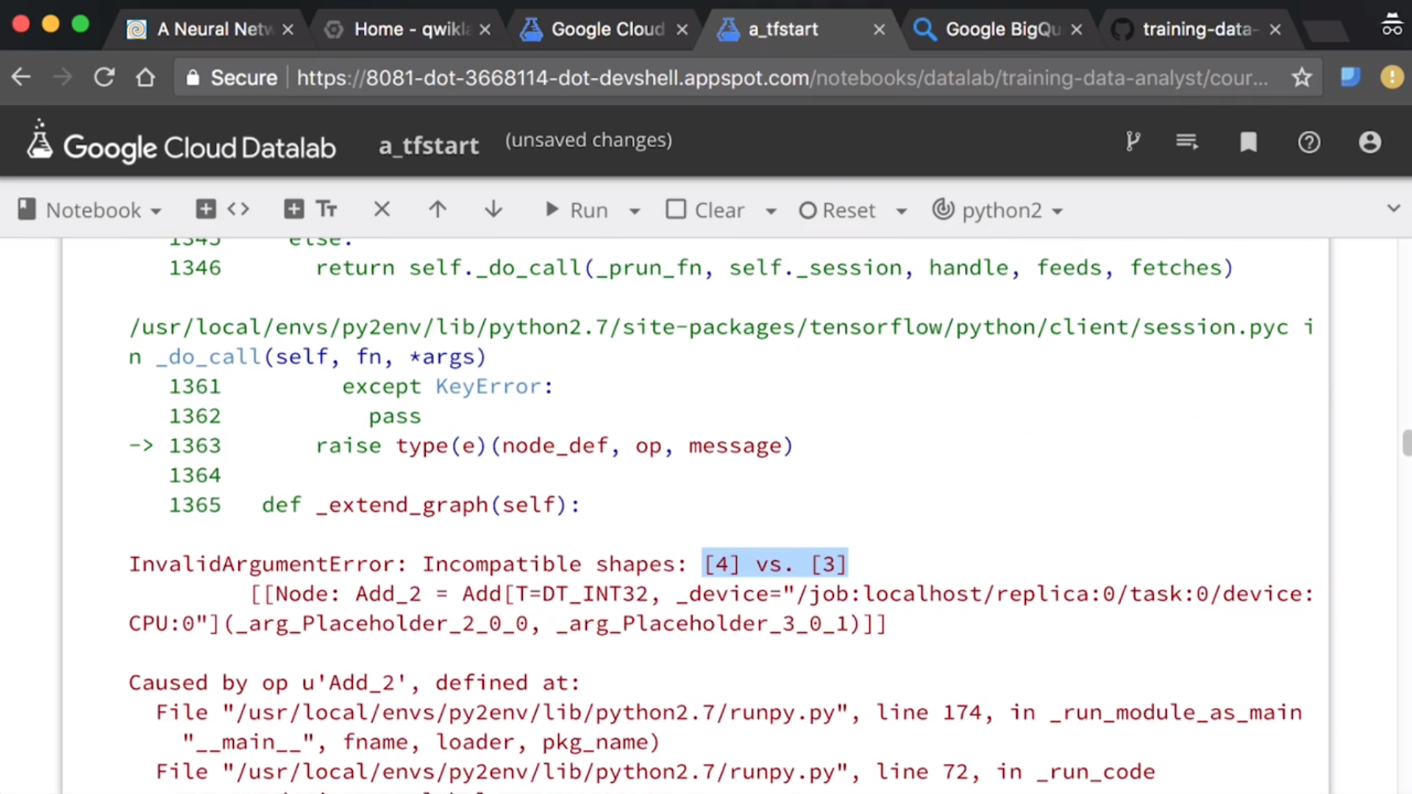

Slide 45
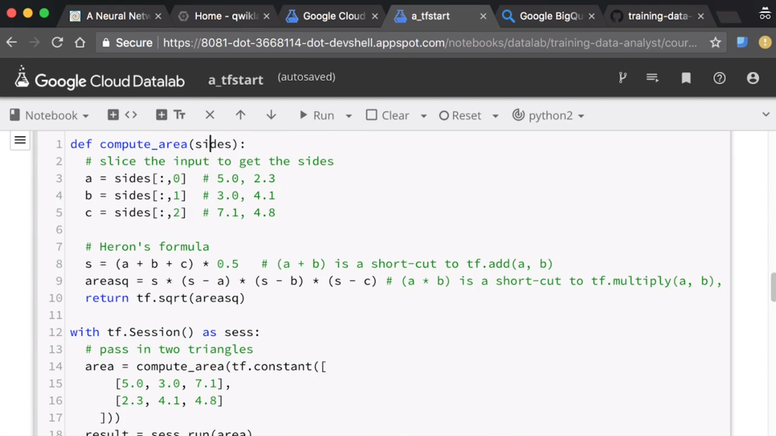

Slide 46
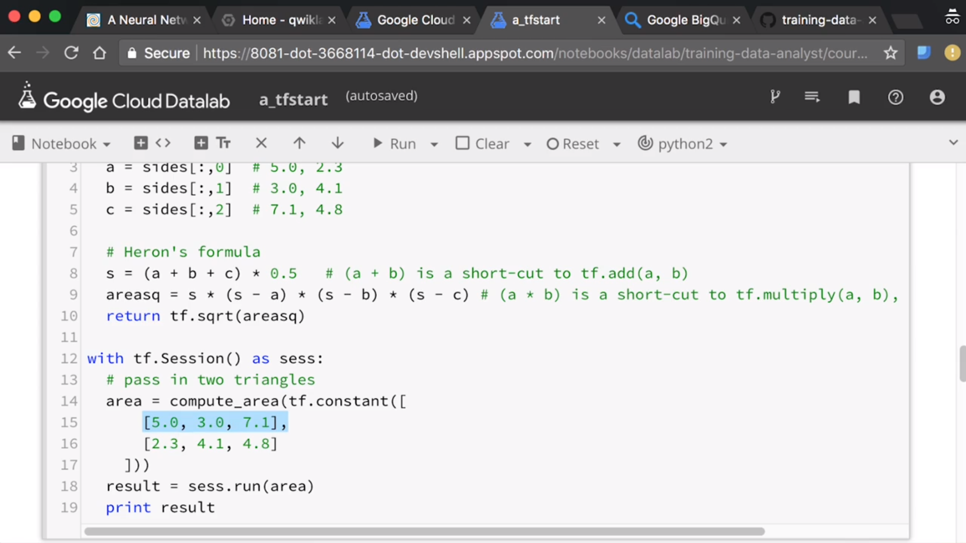

Slide 47
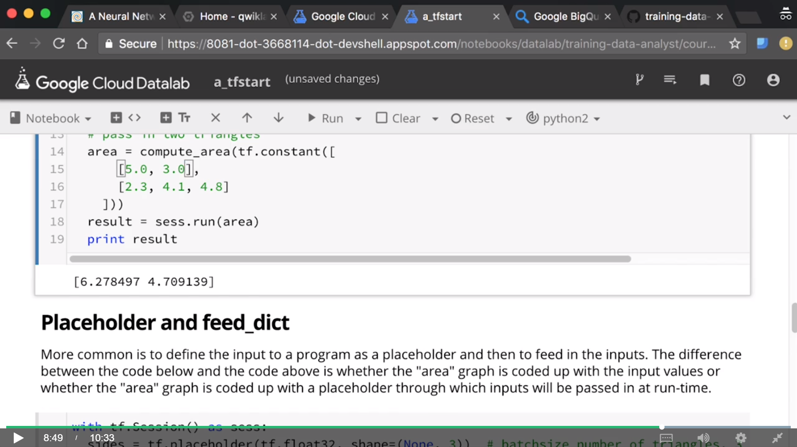

Slide 48
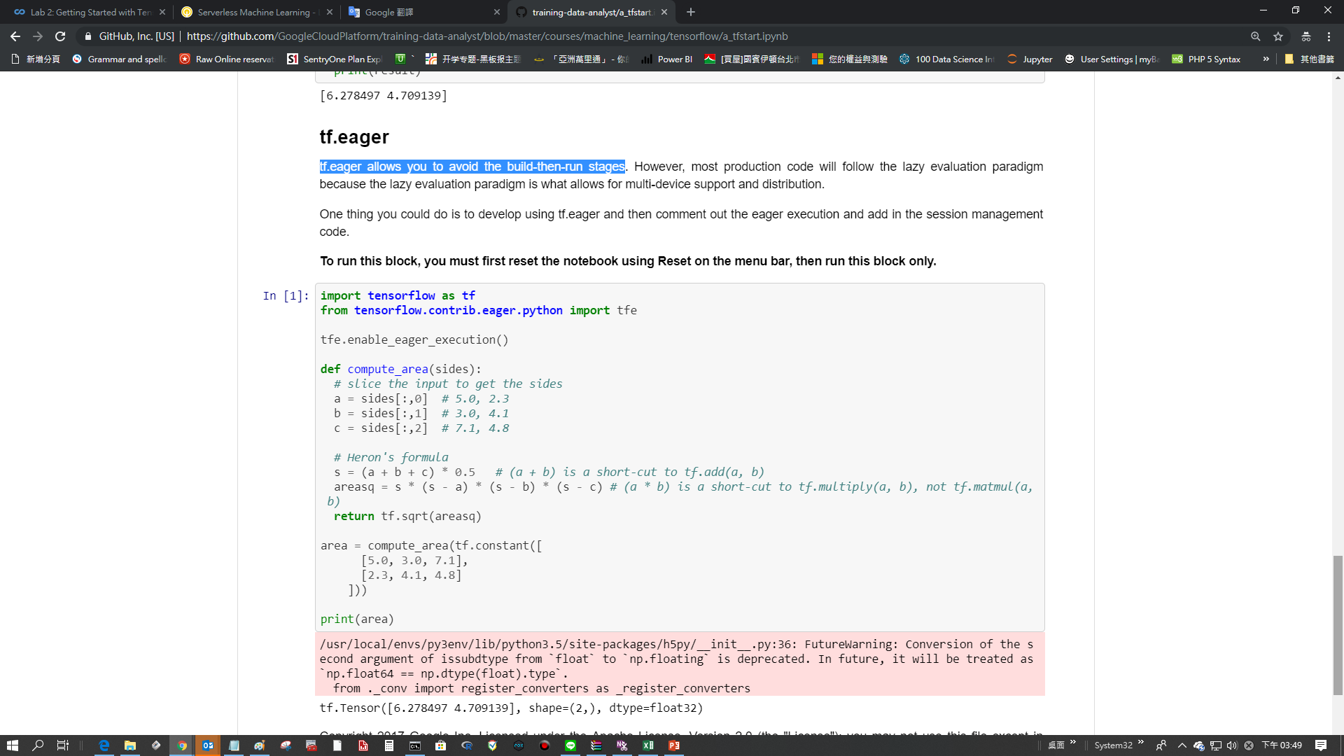

Slide 49
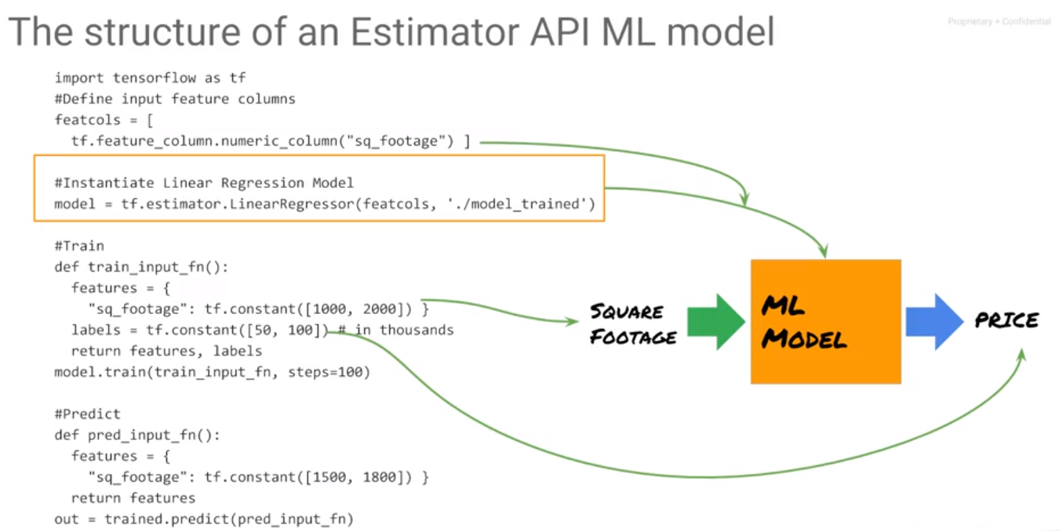
ML concept
Machine Learning
100epoch

Slide 50
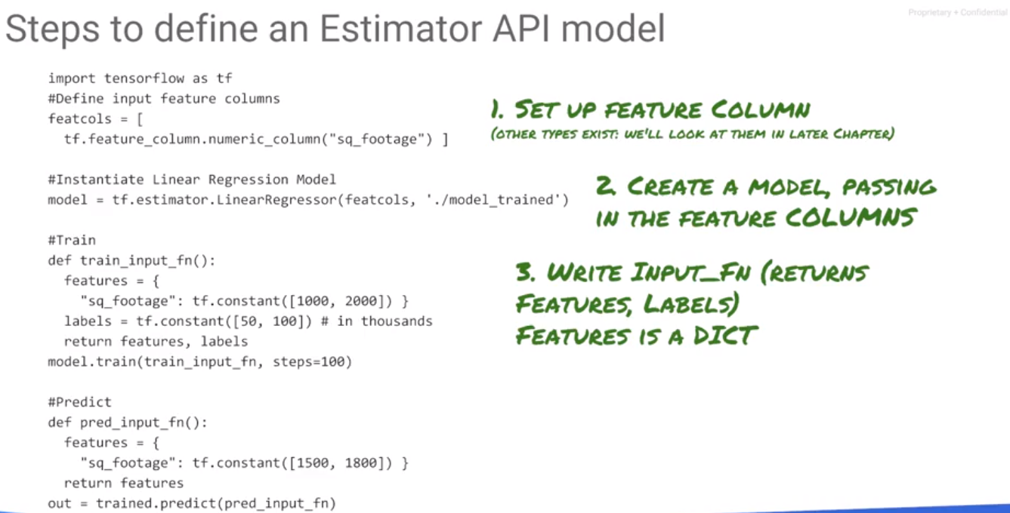
ML concept
Machine Learning

Slide 51
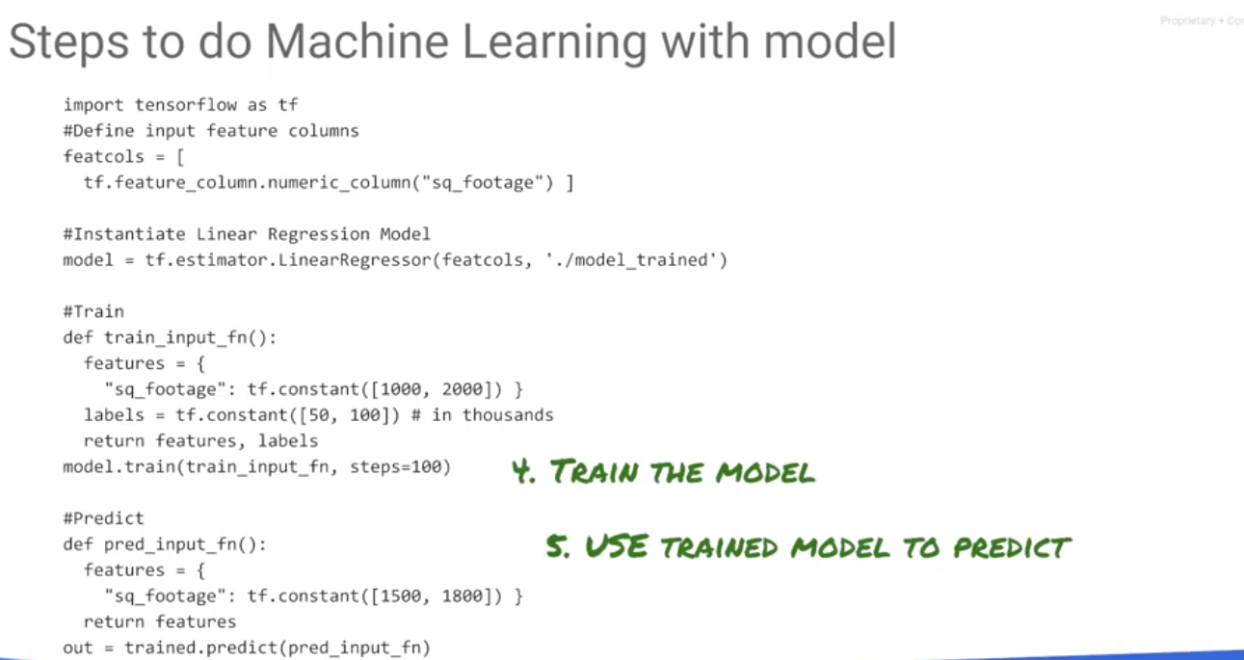
ML concept
Machine Learning
Estimator.train() generate a funcation

Slide 52
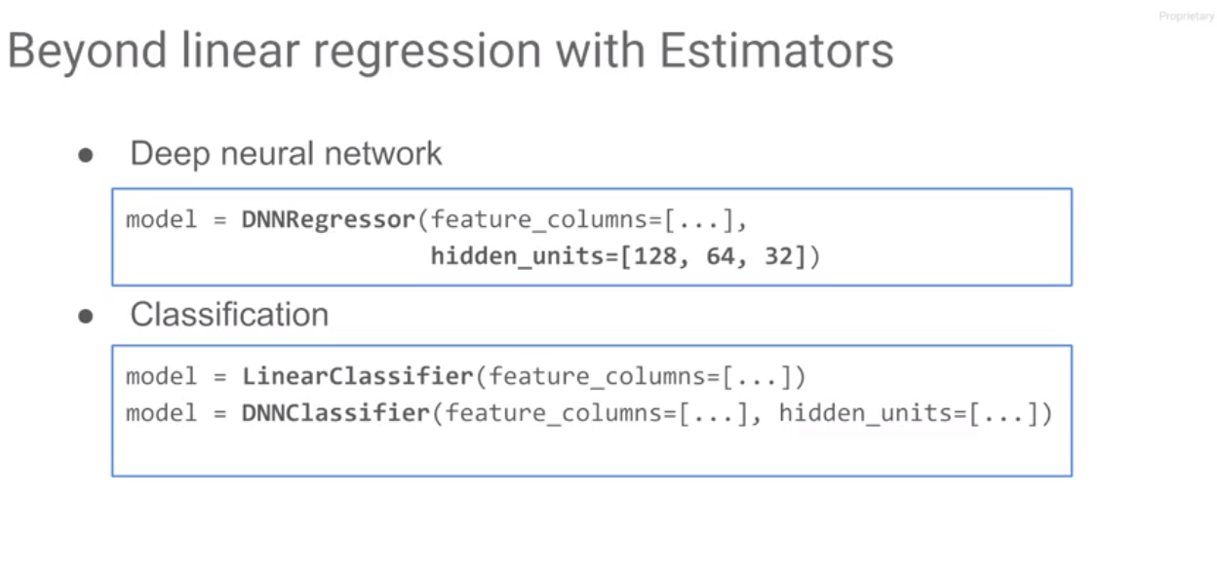
ML concept
Machine Learning
How many layers are there in the DNNRegressor? How many layers and nodes do we need?

Slide 53
ML concept
Machine Learning

Slide 54

Import data
Feature engineering: LABEL batch_size epoch shuffle 1/0

Slide 55

Create Numeric Columns
Remove logs/ errors
Epochs=10

Slide 56

Evaluate model for RMSE

Slide 57

Remove logs/ errors
DNN with 3 hidden layers

Slide 58


Slide 59

ML concept
Machine Learning
Deal with memory problem
Add new feature

Slide 60

ML concept
Machine Learning
Add new feature
Default value/DataType in empty column for NN
predict amount
Dictionary, column name as Key, ZIP (1st Item in first array- 1st item in Second array)
To read small dataSet
mapper

Slide 61

ML concept
Machine Learning
Add new feature
Read data separately for
avoiding memory error
Cant read the whole data in memory
doing gradient descent one batch at a time
Only the last batch might not be size 512
Return feature and label nodes in the TensorFlow graph

Slide 62

TensorFlow way to read the data instead of pandas
return features and label
for every line takes the decode_csv function
Read data by epochs and batch_size
read training data read valid data read testing data

Slide 63

numeric data for NN calculation
derived column, feature engineering
Remove logs/ errors
evaluation

Slide 64

ML concept
Machine Learning
NN Training might fail due to large dataset. Fault-tolerant can save training result as backup just in case it crashed Retrain the model by utilizing back up data
Add new feature

Slide 65

ML concept
Machine Learning
Add new feature
All the worker seeing the same batch data is meaningless. Shuffle it into small piece data to different worker

Slide 66

ML concept
Machine Learning
Botch works and chief

Slide 67

ML concept
Steps, not eopchs with production ready distributed models because
gradient updates from slow workers could get ignored
training a model with fresh data will resume from
a checkpoint corresponding to an earlier number of
steps and those corresponding hyperparameters.
Machine Learning

Slide 68

ML concept
Machine Learning
Training loops will save the model into check point
EvalSpec helps deal with overfitting by loading the hyperparameters from checkpoint
read data from GCP bucket /cloud store/big query

Slide 69

ML concept
Machine Learning

Slide 70

more robust way to train data : train_and_evaluate loop on multiple machines

Slide 71

The same

Slide 72

The same

Slide 73

Vital for deploying model as json data
After TF frame work is set, call train_and_evaluate(estimator, train_spec, eval_spec)

Slide 74

At this point, it’s all about tuning a robust training model

